Slide 1
Finding a best place for a new Chinese restaurant in city of Copenhagen
Song Luo 2021-05-04

Slide 2
Introduction: Business Problem
In this project we will try to find an optimal location for a restaurant. Specifically, this report will be targeted to stakeholders interested in opening a Chinese restaurant in Copenhagen, Denmark.
Since there are lots of restaurants in City of Copenhagen, we will try to detect locations that are not already crowded with restaurants. We are also particularly interested in areas with no Chinese restaurants in vicinity. We would also prefer locations as close to city center as possible, assuming that first two conditions are met.
We will use our data science powers to generate a few most promising neighborhoods based on this criterion. Advantages of each area will then be clearly expressed so that best possible final location can be chosen by stakeholders.

Slide 3
Data
Based on definition of our problem, factors that will influence our decission are:
number of existing restaurants in the neighborhood (any type of restaurant)
number of and distance to Chinese restaurants in the neighborhood, if any
distance of neighborhood from city center
We decided to use regularly spaced grid of locations, centered around city center, to define our neighborhoods.
Following data sources will be needed to extract/generate the required information:
centers of candidate areas will be generated algorithmically and approximate addresses of centers of those areas will be obtained using Google Maps API reverse geocoding
number of restaurants and their type and location in every neighborhood will be obtained using Foursquare API
coordinate of Copenhagen center will be obtained using Google Maps API geocoding of well-known Copenhagen location (Tivoli)

Slide 4
Methodology
In this project we will direct our efforts on detecting areas of Copenhagen that have low restaurant density, particularly those with low number of Chinese restaurants. We will limit our analysis to area ~6km around city center.
In first step we have collected the required data: location and type (category) of every restaurant within 6km from Copenhagen center (Tivoli). We have also identified Chinese restaurants (according to Foursquare categorization).
Second step in our analysis will be calculation and exploration of 'restaurant density' across different areas of Copenhagen - we will use heatmaps to identify a few promising areas close to center with low number of restaurants in general (and no Italian restaurants in vicinity) and focus our attention on those areas.
In third and final step we will focus on most promising areas and within those create clusters of locations that meet some basic requirements established in discussion with stakeholders: we will take into consideration locations with no more than two restaurants in radius of 250 meters, and we want locations without Chinese restaurants in radius of 400 meters. We will present map of all such locations but also create clusters (using k-means clustering) of those locations to identify general zones / neighborhoods / addresses which should be a starting point for final 'street level' exploration and search for optimal venue location by stakeholders.

Slide 5
Analyze
First, count the number of restaurants in area candidate and calculate the distance to nearest Chinese restaurant from every area candidate center (not only those within 300m - we want distance to closest one, regardless of how distant it is)

Slide 6
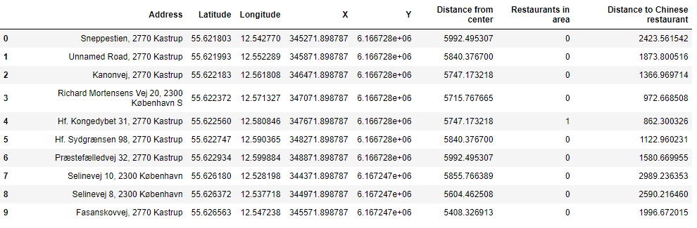

Slide 7
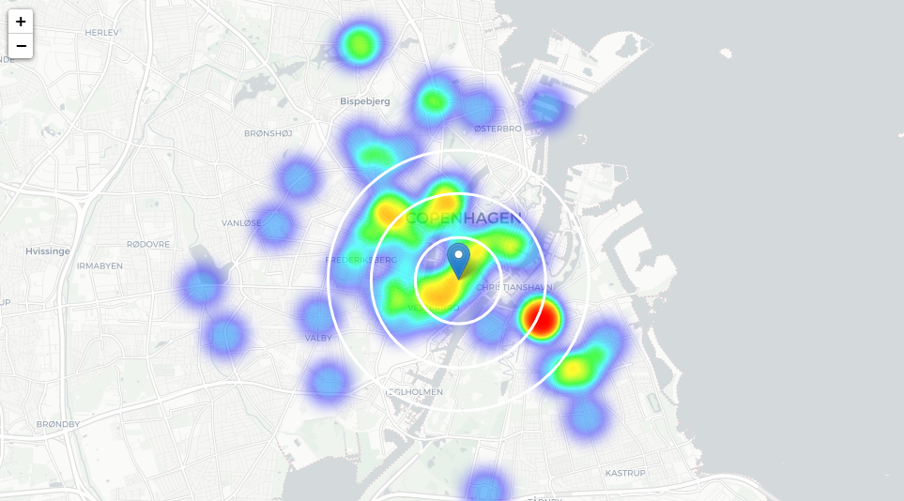
Crete a map showing heatmap / density of restaurants and try to extract some meaningfull info from that. Also, show a few circles indicating distance of 1km, 2km and 3km from Tivoli

Slide 8
Analyses the heatmap / density of restaurants
From above map we can easily find that is not so 'hot' (Chinese restaurants represent a subset of ~6% of all restaurants in Copenhagen) but it also indicates higher density of existing Chinese restaurants directly north and west from Tivoli, with closest pockets of low Chinese restaurant density positioned south-west and north-east from city center.

Slide 9
Analyses of København SV and Amager
Analysis of popular travel guides and web sites often mention København SV and Amager as beautiful, interesting, rich with culture, 'hip' and 'cool' Copenhagen neighborhoods popular with tourists and loved by københavner.
Popular with tourists, alternative and bohemian but booming and trendy, relatively close to city center and well connected, those boroughs appear to justify further analysis.
Let's define new, narrower region of interest, which will include low-restaurant-count parts of København SV and Amager closest to Tivoli.

Slide 10
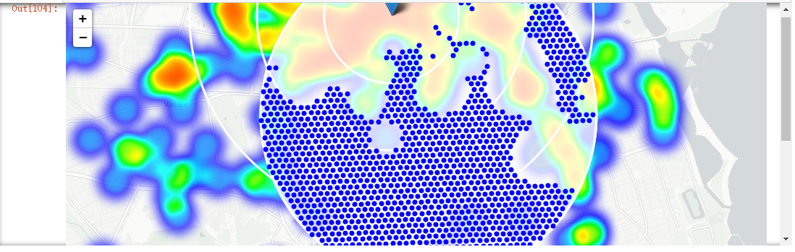
Calculate two most important things for each location candidate: **number of restaurants in vicinity and filter those locations: locations with no more than two restaurants in radius of 250 meters, and no Chinese restaurants in radius of 400 meters. Show on the map

Slide 11
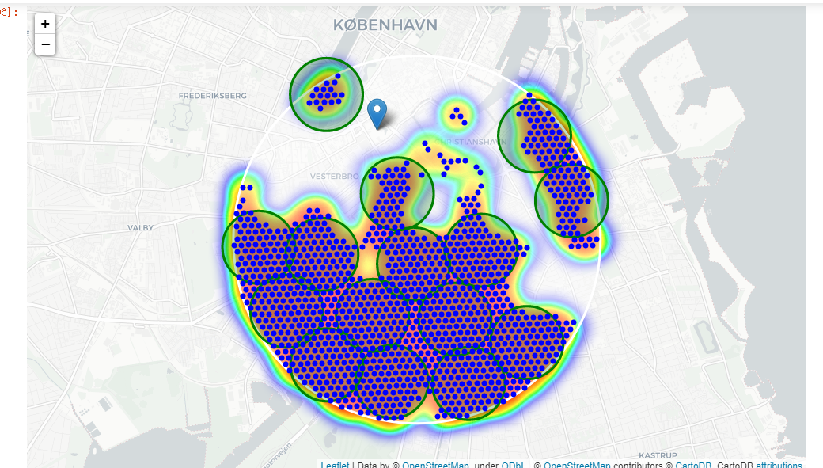
Cluster those locations to create centers of zones containing good locations. Those zones, their centers and addresses will be the final result of our analysis.

Slide 12
Finally, reverse geocode those candidate area centers to get the addresses which can be presented to stakeholders.
Addresses of centers of areas recommended for further analysis
Otto Busses Vej 43, 2450 København => 2.3km from Tivoli
Stjernevej 5, 2300 København => 3.7km from Tivoli
Bryllupstræet, Artillerivej 73A, 2300 København => 1.9km from Tivoli
Lyneborggade 9, 2300 København => 2.8km from Tivoli
Bonderosestien 160, 2300 København => 3.3km from Tivoli
Toldkammeret (Vasbygade), 2450 København => 1.8km from Tivoli
Norsvej 7, 1916 Frederiksberg => 0.8km from Tivoli
Artillerivej 174, 2300 København => 2.5km from Tivoli
Kaj Munks Vej 5, 2300 København => 2.2km from Tivoli
Vejlands Allé 200, 2300 København => 3.4km from Tivoli
Fabriksområdet 86, 1440 København => 2.2km from Tivoli
Teglholmsgade 34, 2.th, 2450 København => 2.7km from Tivoli
Nordre Digevej 52, 2300 København => 2.8km from Tivoli
Grundejerforeningen Havnestads Havnepark - åbent alle dage kl. 7.00-22.00, Islands Brygge 22, 2300 København S => 0.9km from Tivoli
Sundbyvestervej 50, 2300 København => 3.5km from Tivoli

